Slide 1
Integrating Knowledge in Language Models
Most slides are from Natural Language Processing with Deep Learning, Stanford CS224N/Ling284

Slide 2
Lecture Plan
Recap: language models (LMs)
What does a LM know?
Techniques to add knowledge to LMs
  Add pretrained entity embeddings
  Use an external memory
  Modify the training data
  Evaluating knowledge in LMs

Slide 3
Recap: LMs
Standard language models predict the next word in a sequence of text and can compute the probability of a sequence
The students opened their _boo_k_s_.
Masked language models (e.g., BERT) instead predict a masked token in a sequence of text using bidirectional context
went store
I [MASK] to the [MASK].
Both types of language models can be trained over large amounts of unlabeled text!

Slide 4
Recap: LMs
Traditionally, LMs are used for many tasks involving generating or evaluating the probability of text:
  Summarization
  Dialogue
  Autocompletion
  Machine translation
  Fluency evaluation
  ...
Can a language model be used as a knowledge base?

Slide 5
What does a language model know?
iPod Touch is produced by .
London Jazz Festival is located in .
Dani Alves plays with .
Carl III used to communicate in .
Ravens can .
Examples taken from Petroni et al., EMNLP 2019 to test BERT-Large.

Slide 6
What does a language model know?
iPod Touch is produced by ^{Apple} .
London Jazz Festival is located in ^{London} .
Dani Alves plays with ^{Santos} .
Carl III used to communicate in ^{German} .
Ravens can ^{fly} .
Examples taken from Petroni et al., EMNLP 2019 to test BERT-Large.

Slide 7
What does a language model know?
Takeaway: predictions generally make sense (e.g. the correct types), but are not all factually correct.
Why might this happen?
  Unseen facts: some facts may not have occurred in the training corpora at all
  Rare facts: LM hasn’t seen enough examples during training to memorize the fact
  Model sensitivity: LM may have seen the fact during training, but is sensitive to the phrasing of the prompt
    Correctly answers “x was made in y” templates but not “x was created in y”
The inability to reliably recall knowledge is a key challenge facing LMs today!
  Recent works have found LMs can recover some knowledge, but have a way to go.

Slide 8
The importance of knowledge-aware language models
LM pretrained representations can benefit downstream tasks that leverage knowledge
  For instance, extracting the relations between two entities in a sentence is easier with some knowledge of the entities
  We’ll come back to this when talking about evaluation!
Stretch goal: can LMs ultimately replace traditional knowledge bases?
  Instead of querying a knowledge base for a fact (e.g. with SQL), query the LM with a natural language prompt!
    Of course, this requires LM to have high quality on recalling facts

Slide 9
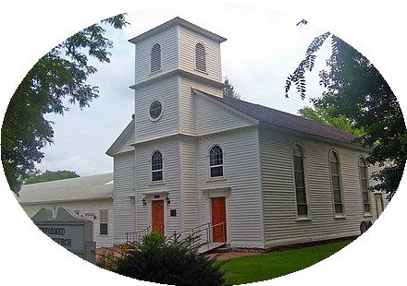


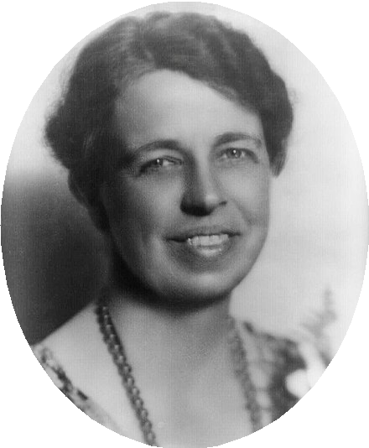

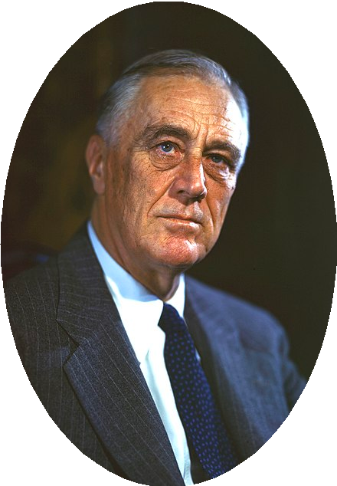

Querying traditional knowledge bases
Hyde Park
January 30, 1882
October 11, 1884
place of birth
date of
date of birth
birth
spouse
Eleanor Roosevelt
Franklin D. Roosevelt
type
type
Query knowledge base with SQL statements
SELECT date of birth
WHERE person = “Franklin D. Roosevelt”
human

Slide 10
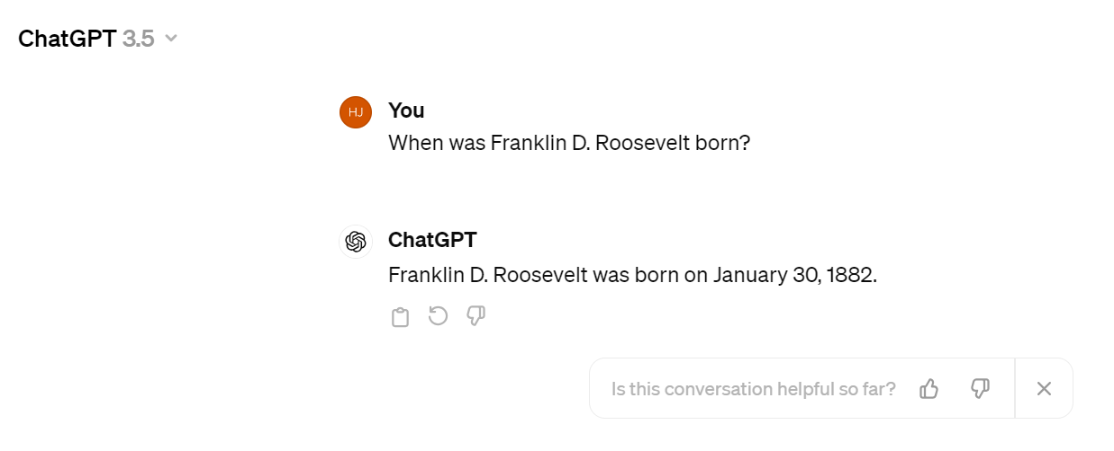

Slide 11
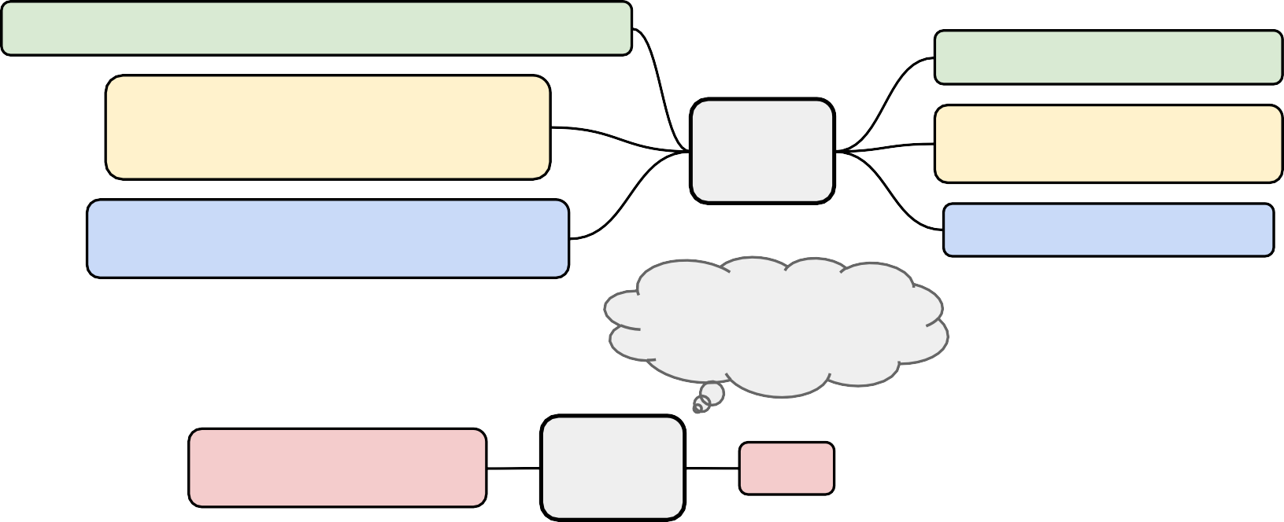
Querying language models as knowledge bases
Pretrain LM over unstructured text and then query with natural language.
President Franklin <M> born <M> January 1882.
D. Roosevelt was <M> in
Lily couldn't <M>. The waitress had brought the largest <M> of chocolate cake <M> seen.
T5
President Franklin D.
believe her eyes <M> piece <M> she had ever
Our <M> hand-picked and sun-dried
<M> orchard in Georgia.
peaches are <M> at our
Pre-training
Roosevelt was born in January 1882.
Fine-tuning
T5
When was Franklin D. Roosevelt born?
1882
Roberts et al., EMNLP 2020

Slide 12
Advantages of language models over traditional KBs
LMs are pretrained over large amounts of unstructured and unlabeled text
  KBs require manual annotation or complex NLP pipelines to populate
LMs support more flexible natural language queries
  Example: What does the final F in the song U.F.O.F. stand for?
    Traditional KB wouldn’t have a field for “final F”; LM may learn this
However, there are also many open challenges to using LMs as KBs:
  Hard to interpret (i.e., why does the LM produce an answer)
  Hard to trust (i.e., the LM may produce a realistic, incorrect answer)
  Hard to modify (i.e., not easy to remove or update knowledge in the LM)
Petroni et al., EMNLP 2019 & Roberts et al., EMNLP 2020

Slide 13
Section 2:
Techniques to add knowledge to LMs

Slide 14



Techniques to add knowledge to LMs
Add pretrained entity embeddings
ERNIE
KnowBERT
token embs
entity embs
keys values
Use an external memory
KGLM
kNN-LM
Modify the training data
•
•
WKLM
ERNIE (another!), salient span masking
corrupted tokens

Slide 15
Techniques to add knowledge to LMs
Add pretrained entity embeddings
ERNIE
KnowBERT
token embs
entity embs
keys values
Use an external memory
KGLM
kNN-LM
Modify the training data
•
•
WKLM
ERNIE (another!), salient span masking
corrupted tokens

Slide 16
Method 1: Add pretrained entity embeddings
Facts about the world are usually in terms of entities
  Example: Washington was the first president of the United States.
Pretrained word embeddings do not have a notion of entities
  Different word embeddings for “U.S.A.”, “United States of America” and “America” even though these refer to the same entity
What if we assign an embedding per entity?
  Single entity embedding for “U.S.A.”, “United States of America” and “America”
Entity embeddings can be useful to LMs iff you can do entity linking well!

Slide 17
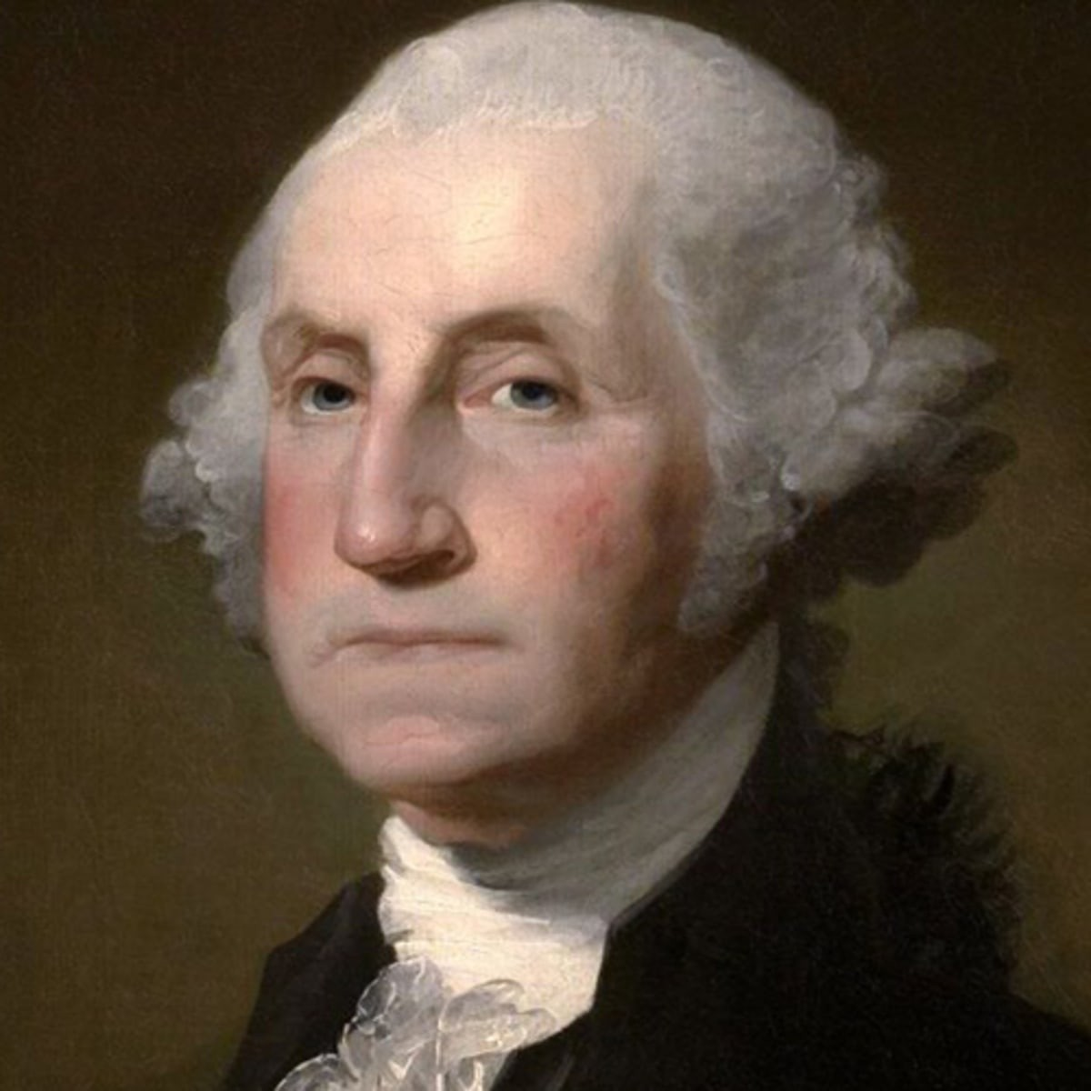
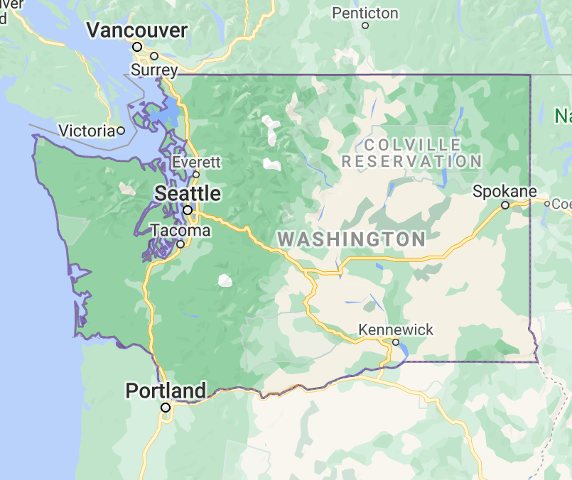

Aside: What is entity linking?
Link mentions in text to entities in a knowledge base
mention mention
Washington was the first president of the United States.
candidate
candidate
candidate
Q23 (Wikidata) Q1223 (Wikidata) Q30 (Wikidata)
Entity linking tells us which entity embeddings are relevant to the text
More resources: Orr et al., CIDR 2021 & Li et al., EMNLP 2020
16

Slide 18
Method 1: Add pretrained entity embeddings
Entity embeddings are like word embeddings, but for entities in a knowledge base!
0.111
-0.345
0.876
-0.201
George Washington =
Many techniques for training entity embeddings:
Knowledge graph embedding methods (e.g., TransE)
Word-entity co-occurrence methods (e.g., Wikipedia2Vec)
Transformer encodings of entity descriptions (e.g., BLINK)

Slide 19
Method 1: Add pretrained entity embeddings
Question: How do we incorporate pretrained entity embeddings from a different embedding space?
Answer: Learn a fusion layer to combine context and entity information.
𝒉_{j} = 𝐹 𝑾_{𝑡}𝒘_{j} + 𝑾_{𝑒}𝒆_{𝑘} + 𝑏
We assume there’s a known alignment between entities and words in the sentence such that 𝑒_{𝑘} = 𝑓 𝑤_{j}
𝒘_{j} is the embedding of word 𝑗 in a sequence of words
𝒆_{𝑘} is the corresponding entity embedding

Slide 20
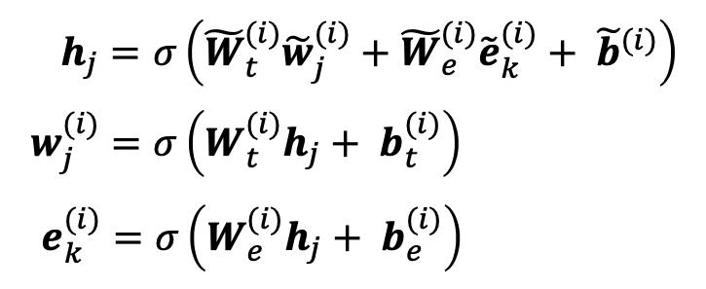
ERNIE: Enhanced Language Representation with Informative Entities [Zhang et al., ACL 2019]
Text encoder: multi-layer bidirectional Transformer encoder over the words in the sentence
Knowledge encoder: stacked blocks composed of:
  Two multi-headed attentions (MHAs) over entity embeddings and token embeddings
  A fusion layer to combine the output of the MHAs

Slide 21
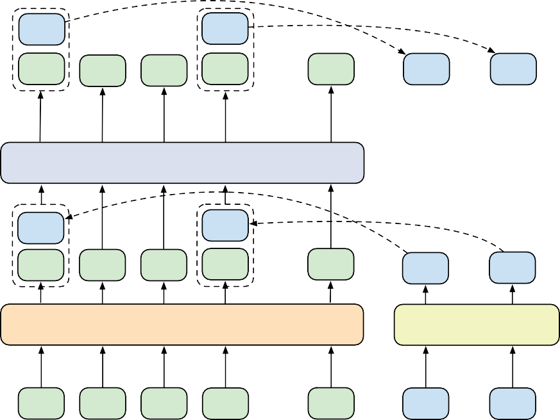
ERNIE: Enhanced Language Representation with Informative Entities
_{e}(i) _{e}(i)
1 2
Token Output
Entity Output
Token Output
_{w}(i) _{w}(i) _{w}(i) _{w}(i)
1 2 3 4
···
_{w}(i)
_{e}(i)
_{e}(i)
Entity Output
Aggregator
n
1
2
Information Fusion
Aggregator
K-Encoder Mx
Information Fusion
Multi-Head Attention
Multi-Head Attention
_{e˜}(i)
_{e˜}(i)
1
2
_{w˜}(i)
_{w˜}(i)
_{w˜}(i)
_{w˜}(i)
···
_{w˜}(i)
(i)
(i)
1
2
3
4
n
e˜₁
e˜₂
Transformer
Feed Forward
Entity Input
Multi-Head Attention
Multi-Head Attention
T-Encoder Nx
Multi-Head Attention
Token Input
_{w}(i—1)
_{w}(i—1)
_{w}(i—1)
_{w}(i—1)
···
_{w}(i—1)
_{e}(i—1) _{e}(i—1)
1 2
Entity Input
1
bob
2
dylan
3
wrote
4
n
1962
blow
Bob Dylan Blowin’ in the Wind
Token Input
Bob Dylan wrote Blowin’ in the Wind in 1962
(b) Aggregator
(a) Model Achitecture

Slide 22
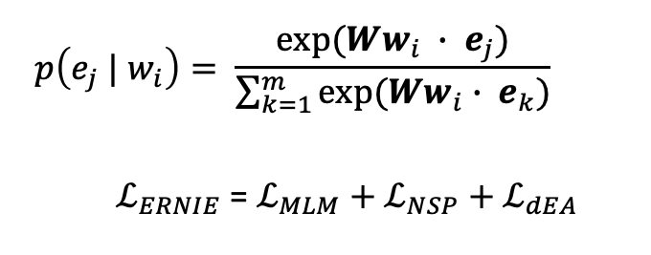
ERNIE: Enhanced Language Representation with Informative Entities
Pretrain with three tasks:
  Masked language model and next sentence prediction (i.e., BERT tasks)
  Knowledge pretraining task (dEA¹): randomly mask token-entity alignments and predict corresponding entity for a token from the entities in the sequence
[1] dEA named for denoising entity autoencoder from Vincent et al., ICML 2008.

Slide 23
ERNIE: Enhanced Language Representation with Informative Entities
Additional knowledge pretraining task is necessary to make the most use of the pretrained entity embeddings.
90
88
86
84
82
F1 on FewRel
BERT
ERNIE
no entity embs
no knowledge task
22

Slide 24
ERNIE: Enhanced Language Representation with Informative Entities
Strengths:
  Combines entity + context info through fusion layers and a knowledge pretraining task
  Improves performance downstream on knowledge-driven tasks
Remaining challenges:
  Needs text data with entities annotated as input, even for downstream tasks
    For instance, “Bob Dylan wrote Blowin’ in the Wind” needs entities pre-linked to input entities into ERNIE
  Requires further (expensive) pretraining of the LM¹
[1] Check out Poerner et al., EMNLP 2020 for a method to avoid more LM pretraining.
23

Slide 25
Jointly learn to link entities with KnowBERT [Peters et al., EMNLP 2019]
Key idea: pretrain an integrated entity linker (EL) as an extension to BERT
Predict over set of hard
^{ℒ}𝐾𝑛𝑜w𝐵𝐸𝑅𝑇 ^{= ℒ}𝑁𝑆𝑃 ^{+ ℒ}𝑀𝐿𝑀 ^{+ ℒ}𝐸𝐿
candidates (not just those in sentence)
On downstream tasks, EL predicts entities so entity annotations aren’t required
Learning EL may better encode knowledge - shows performance gains over ERNIE on downstream tasks
Like ERNIE, KnowBERT uses a fusion layer to combine entity and context information and adds a knowledge pretraining task

Slide 26
Techniques to add knowledge to LMs
Add pretrained entity embeddings
ERNIE
KnowBERT
token embs
entity embs
keys values
Use an external memory
KGLM
kNN-LM
Modify the training data
WKLM
ERNIE (another!), salient span masking
corrupted tokens

Slide 27
Method 2: Use an external memory
Previous methods rely on the pretrained entity embeddings to encode the factual knowledge from KBs for the language model.
Question: Are there more direct ways than pretrained entity embeddings to provide the model factual knowledge?
Answer: Yes! Give the model access to an external memory (a key-value store with access to KG triples or context information)
Advantages:
  Can better support injecting and updating factual knowledge
    Often without more pretraining!
  More interpretable

Slide 28




Barack's Wife Hillary: Using Knowledge-Graphs for Fact-Aware Language Modeling (KGLM) [Logan et al., ACL 2019]
Key idea: condition the language model on a knowledge graph (KG)
Recall that language models predict the next word by computing
P 𝑥^{(𝑡+1)} 𝑥^{(𝑡)}, … , 𝑥⁽¹⁾), where 𝑥⁽¹⁾, … . , 𝑥^{(𝑡)} is a sequence of words
Now, predict the next word using entity information, by computing
_{P 𝑥}(𝑡+1)_{, ℇ}(𝑡+1) _{𝑥}(𝑡)_{, … , 𝑥} 1 _{, ℇ} 𝑡 _{, … , ℇ} 1
)
where ℇ ^{𝑡} is the set of KG entities mentioned at timestep 𝑡

Slide 29
KGLM [Logan et al., ACL 2019]
Build a “local” knowledge graph as you iterate over the sequence
  Local KG: subset of the full KG with only entities relevant to the sequence
Super Mario Land is a game developed by Nintendo .
Assumes entities are known during training!
Super Mario Land
Q647249
publisher
Nintendo
Q8093
launch game
Q1425505
Publication Date
platform
manufacturer
genre
21 April 1989
Date
platform game
Q828322
Game Boy
Q186437
When should the LM use the local KG to predict the next word?

Slide 30
KGLM
Super Mario Land is a game developed by
New entity Not an entity
Nintendo
.
Related entity
Classify: Is the next word…
Related entity (in the local KG)
New entity (not in the local KG)
Not an entity
Super Mario Land
Q647249
publisher
Nintendo
Q8093
launch game
Q1425505
Publication Date
platform
manufacturer
genre
…
…
21 April 1989
Date
platform game
Q828322
Game Boy
Q186437
Super
developed
by
Use the LSTM hidden state to predict the type of the next word (3 classes)
How does the LM predict the next entity and word in each case?

Slide 31
KGLM
Super Mario Land is a game developed by Nintendo.
New entity Not an entity Related entity
Related entity (in the local KG)
KG triple = (parent entity, relation, tail entity)
Super Mario Land
Q647249
publisher
Nintendo
Q8093
launch game
Q1425505
Example
platform
manufacturer
Top scoring parent entity: “Super Mario Land”
Top scoring relation: “publisher”
-> Next entity is “Nintendo”, due to KG triple (Super Mario Land, publisher, Nintendo).
Publication Date
genre
21 April 1989
Date
platform game
Q828322
Game Boy
Q186437

Slide 32
KGLM
Super Mario Land is a game developed by Nintendo.
New entity Not an entity Related entity
Related entity (in the local KG)
Find the top-scoring parent and relation in the local KG using the LSTM hidden state and pretrained entity and relation embeddings
  𝑃 𝑝_{𝑡} = softmax 𝒗_{𝒑 .} 𝒉_{𝒕} where 𝑝_{𝑡} is the “parent” entity, 𝒗_{𝒑} is the corresponding entity embedding, and 𝒉_{𝒕} is from the LSTM hidden state
Next entity: tail entity from KG triple of (top parent entity, top relation, tail entity)
Next word: most likely next token over vocabulary expanded to include entity aliases¹
[1] Phrases that could refer to Nintendo (e.g. Nintendo, Nintendo Co., Koppai)

Slide 33
KGLM
Super Mario Land is a game developed by Nintendo.
New entity Not an entity Related entity
New entity (not in the local KG)
Find the top-scoring entity in the full KG using the LSTM hidden state and pretrained entity embeddings
Next entity: directly predict top-scoring entity
Next word: most likely next token over vocabulary expanded to include entity aliases
Not an entity
Next entity: None
Next word: most likely next token over standard vocabulary

Slide 34
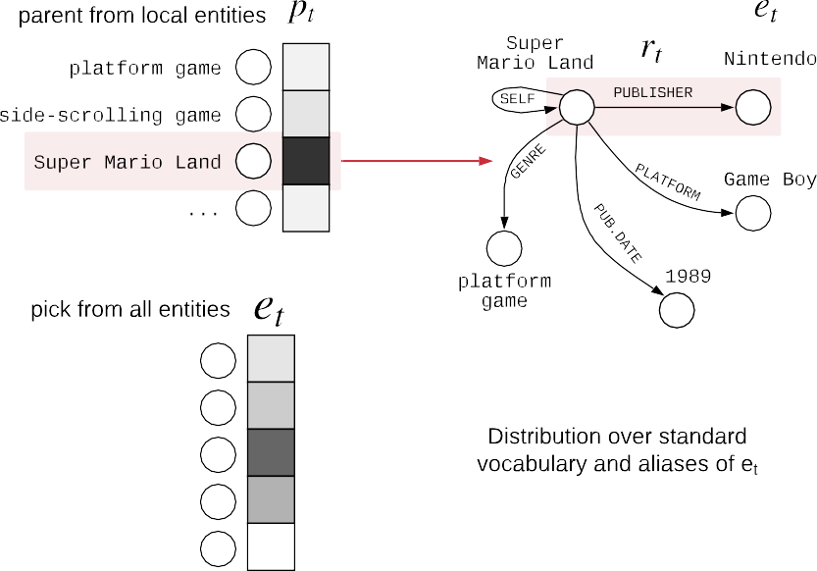
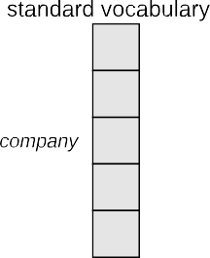
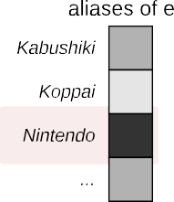


KGLM

Slide 35
KGLM [Logan et al., ACL 2019]
Outperforms GPT-2 and AWD-LSTM¹ on a fact completion task
Qualitatively, compared to GPT-2, KGLM tends to predict more specific tokens (GPT-2 predicts more popular, generic tokens)
Supports modifying/updating facts!
  Modifying the KG has a direct change in the predictions
Barack Obama was born on .
KG triples:
(Barack Obama, birthDate, 1961-08-04) (Barack Obama, birthDate, 2013-03-21)
Most likely next word:
“August”, “4”, “1961”
“March”, “21”, “2013”
[1] Merity et al., ICLR 2018
34

Slide 36
Nearest Neighbor Language Models (kNN-LM)
[Khandelwal et al., ICLR 2020]
Key idea: learning similarities between text sequences is easier than predicting the next word
  Example: “Dickens is the author of ” ≈ “Dickens wrote ”
  Qualitatively, researchers find this is especially true for “long-tail patterns”, such as rare facts
So, store all representations of text sequences in a nearest neighbor datastore!
At inference:
Find the k most similar sequences of text in the datastore
Retrieve the corresponding values (i.e. the next word) for the k sequences
Combine the kNN probabilities and LM probabilities for the final prediction
𝑃 𝑦 𝑥 = 𝜆𝑃_{𝑘𝑁𝑁} 𝑦 𝑥 + (1 − 𝜆)𝑃_{𝐿𝑀} 𝑦 𝑥
[1] 𝜆 is a tuned hyperparameter
35

Slide 37





More recent takes: Nearest Neighbor Language Models (kNN-LM)
Training Contexts | Targets
Shakespeare wrote | Macbeth
Dickens is the author of | Oliver
The Bard’s famous play | Hamlet
… | …
Shakespeare authored | Macbeth
Representations
Distances
Nearest k
Macbeth | 3
Hamlet | 4
Macbeth | 5
Normalization
Macbeth | 0.7
Hamlet | 0.2
Macbeth | 0.1
Aggregation
Macbeth | 0.8
Hamlet | 0.2
4
100
5
… 3
Classification
Macbeth | 0.1
Hamlet | 0.2
… | …
Interpolation
Macbeth | 0.7
Hamlet | 0.2
… | …
Test Context | Target
Shakespeare’s play | ?
Representation

Slide 38
Techniques to add knowledge to LMs
Add pretrained entity embeddings
• ERNIE
token embs entity embs _{• KnowBERT}
^{keys values} Use an external memory
• KGLM
• kNN-LM
Modify the training data
WKLM
ERNIE (another!), salient span masking
corrupted tokens

Slide 39
Method 3: Modify the training data
Previous methods incorporated knowledge explicitly through pretrained embeddings and/or an external memory.
Question: Can knowledge also be incorporated implicitly through the unstructured text?
Answer: Yes! Mask or corrupt the data to introduce additional training tasks that require factual knowledge.
Advantages:
  No additional memory/computation requirements
  No modification of the architecture required

Slide 40
Pretrained Encyclopedia: Weakly Supervised Knowledge- Pretrained Language Model (WKLM) [Xiong et al., ICLR 2020]
Key idea: train the model to distinguish between true and false knowledge
Replace mentions in the text with mentions that refer to different entities of the same type to create negative knowledge statements
  Model predicts if entity as been replaced or not
  Type-constraint is intended to enforce linguistically correct sentences
True knowledge statement:
J.K. Rowling is the author of Harry Potter.
Negative knowledge statement:
J.R.R. Tolkien is the author of Harry Potter.

Slide 41
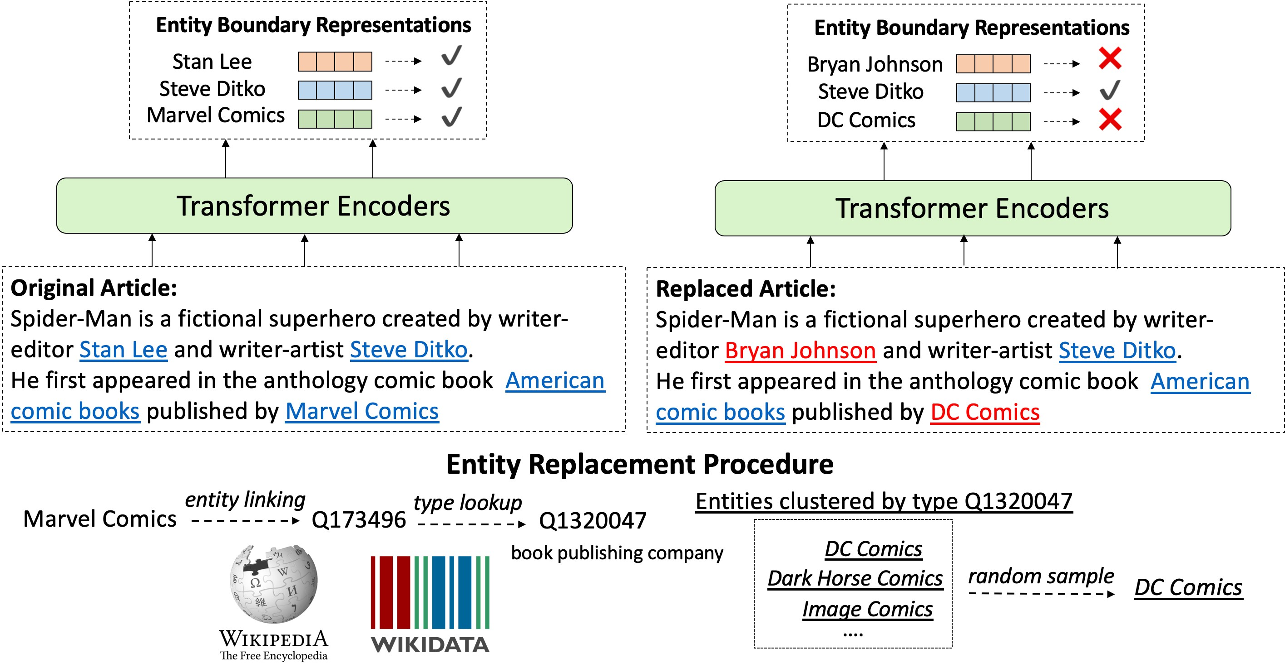
WKLM

Slide 42
WKLM
Uses an entity replacement loss to train the model to distinguish between true and false mentions
ℒ_{𝑒𝑛𝑡𝑅𝑒𝑝} = 𝕝_{𝑒∈ℇ}+ log 𝑃 𝑒 𝐶) + (1 − 𝕝_{𝑒∈ℇ}+ ) log(1 − 𝑃 𝑒 𝐶))
where e is an entity, C is the context, and ℇ⁺ represents a true entity mention
Total loss is the combination of standard masked language model loss (MLM) and the entity replacement loss.
^{ℒ}𝖶𝐾𝐿𝑀 ^{= ℒ}𝑀𝐿𝑀 ^{+ ℒ}𝑒𝑛𝑡𝑅𝑒𝑝
MLM is defined at the token-level; entRep is defined at the entity-level

Slide 43
WKLM
Improves over BERT and GPT-2 in fact completion tasks
Improves over ERNIE on a downstream task (entity typing)
Ablation experiments
  MLM loss is essential for downstream task performance
  WKLM outperforms training longer with just MLM loss
Model | SQuAD (F1) | TriviaQA (F1) | Quasar-T (F1) | FIGER (acc)
WKLM | 91.3 | 56.7 | 49.9 | 60.21
WKLM w/o MLM | 87.6 | 52.5 | 48.1 | 58.44
BERT + 1M Updates | 91.1 | 56.3 | 48.2 | 54.17
Much worse without MLM
Much worse training for longer, compared to using the entity replacement loss

Slide 44
Learn inductive biases through masking
Can we encourage the LM to learn factual knowledge by being clever about masking?
Thread in several works:
  ERNIE¹: Enhanced Representation through Knowledge Integration, Sun et al., arXiv 2019
    Shows improvements on downstream Chinese NLP tasks with phrase-level and entity-level masking
  How Much Knowledge Can You Pack Into the Parameters of a Language Model?, Roberts et al., EMNLP 2020
    Uses “salient span masking” (Guu et al., ICML 2020) to mask out salient spans (i.e. named entities and dates)
    Shows that salient span masking helps T5 performance on QA
[1] Yes, another ERNIE paper!
43

Slide 45
ERNIE¹: Enhanced Representation through Knowledge Integration
[Sun et al., arXiv 2019]
BERT
[1] Yes, another ERNIE paper!
Haffy
Of
wfitten
K·
Tfa n s f Ofm ef
[mask]
POttef
is
a
sefies
[mask]
fantasy
nOvel
[mask]
by
J·
[mask]
ROwlin
ERNIE
a
sefies
Of
wfitten
J·
K·
ROwlin
Tra n s f Ormer
Haffy
POttef
is
[mask]
[mask]
[mask]
fantasy
nOvel
[mask]
by
[mask]
[mask]
[mask]

Slide 46


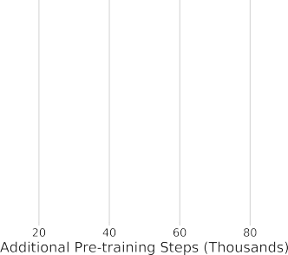

Salient span masking
Salient span masking has been shown to outperform other masking/corruption strategies on retrieval and QA tasks.
REALM on Natural Questions
Masking technique | Exact Match | Retrieval Recall @5
Salient span masking | 38.2 | 38.5
Random uniform masks | 32.3 | 24.2
Random span masks | 35.3 | 26.1
Guu et al., ICML 2020
Roberts et al., EMNLP 2020

Slide 47
Recap: Techniques to add knowledge to LMs
Use pretrained entity embeddings
  Often not too difficult to apply to existing architectures to leverage KG pretraining
  Indirect way of incorporating knowledge and can be hard to interpret
Add an external memory
  Can support some updating of factual knowledge and easier to interpret
  Tend to be more complex in implementation and require more memory
Modify the training data
  Requires no model changes or additional computation. May also be easiest to theoretically analyze! Active area of research
  Still open question if this is always as effective as model changes

Slide 48

Section 3: Evaluating knowledge in LMs

Slide 49

LAnguage Model Analysis (LAMA) Probe [Petroni et al., EMNLP 2019]
How much relational (commonsense and factual) knowledge is already in off-the-shelf language models?
  Without any additional training or fine-tuning
Manually constructed a set of cloze statements to assess a model’s ability to predict a missing token. Examples:
The theory of relativity was developed by [MASK].
The native language of Mammootty is [MASK].
Ravens can [MASK].
You are likely to find a overflow in a [MASK].

Slide 50
LAnguage Model Analysis (LAMA) Probe
Generate cloze statements from KG triples and question-answer pairs
Compare LMs to supervised relation extraction (RE) and question answering systems
Goal: evaluate knowledge present in existing pretrained LMs (this means they may have different pretraining corpora!)
Mean precision at one (P@1)
BERT struggles on N-to-M relations
Corpus | DrQA | RE baseline | fairseq- fconv | Transformer- XL | ELMo | ELMo (5.5B) | BERT- base | BERT- large
Google-RE | - | 7.6 | 2.6 | 1.6 | 2.0 | 3.0 | 9.8 | 10.5
T-REx | - | 33.8 | 8.9 | 18.3 | 4.7 | 7.1 | 31.1 | 32.2
ConceptNet | - | - | 3.6 | 5.7 | 6.1 | 6.2 | 15.6 | 19.2
SQuAD | 37.5 | - | 3.6 | 3.9 | 1.6 | 4.3 | 14.1 | 17.4
LMs are NOT finetuned!
49

Slide 51
LAnguage Model Analysis (LAMA) Probe
Limitations of the LAMA probe:
  Hard to understand why models perform well when they do
    BERT-large may be memorizing co-occurrence patterns rather than “understanding” the cloze statement
    LM could just be identifying similarities between the surface forms of the subject and object (e.g., Pope Clement VII has the position of pope)
  LMs are sensitive to the phrasing of the statement
    LAMA has only one manually defined template for each relation
    This means probe results are a lower bound on knowledge encoded in the LM

Slide 52
A More Challenging Probe: LAMA-UnHelpful Names (LAMA-UHN)
[Poerner et al., EMNLP 2020]
Key idea: Remove the examples from LAMA that can be
answered without relational knowledge
Native language of French-speaking actors according to BERT
Observation: BERT may rely on surface forms of entities to make predictions
  String match between subject and object
  “Revealing” person name
    Name can be a (possibly incorrect) prior for native language, place of birth, nationality, etc.
Person Name | BERT
Jean Marais | French
Daniel Ceccaldi | Italian
Orane Demazis | Albanian
Sylvia Lopez | Spanish
Annick Alane | English
BERT’s score on LAMA drops ~8% with LAMA-UHN
  Knowledge-enhanced model E-BERT score drops only <1%

Slide 53
Developing better prompts to query knowledge in LMs
[Jiang et al., TACL 2020]
LMs may know the fact, but fail on completion tasks like LAMA due to the query itself
  Pretraining may be on different contexts and sentence structures than the query
Example: “The birth place of Barack Obama is Honolulu, Hawaii” (pretraining corpus) versus “Barack Obama was born in ” (query)
Generate more LAMA prompts by mining templates from Wikipedia¹ and generating paraphrased prompts by using back-translation
Ensemble prompts to increase diversity of contexts that fact can be seen in
[1] One mining approach uses dependency parsing to build the template!
53

Slide 54
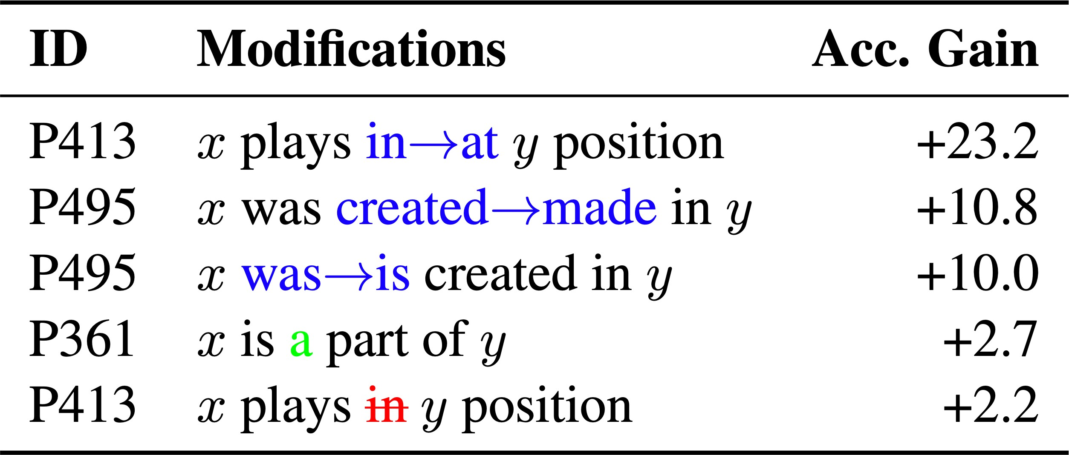
Developing better prompts to query knowledge in LMs
[Jiang et al., TACL 2020]
Performance on LAMA for BERT-large increases 7% when using top-performing query for each relation. Ensembling leads to another 4% gain.
Small changes in the query lead to large gains.
  LMs are extremely sensitive to the query!

Slide 55
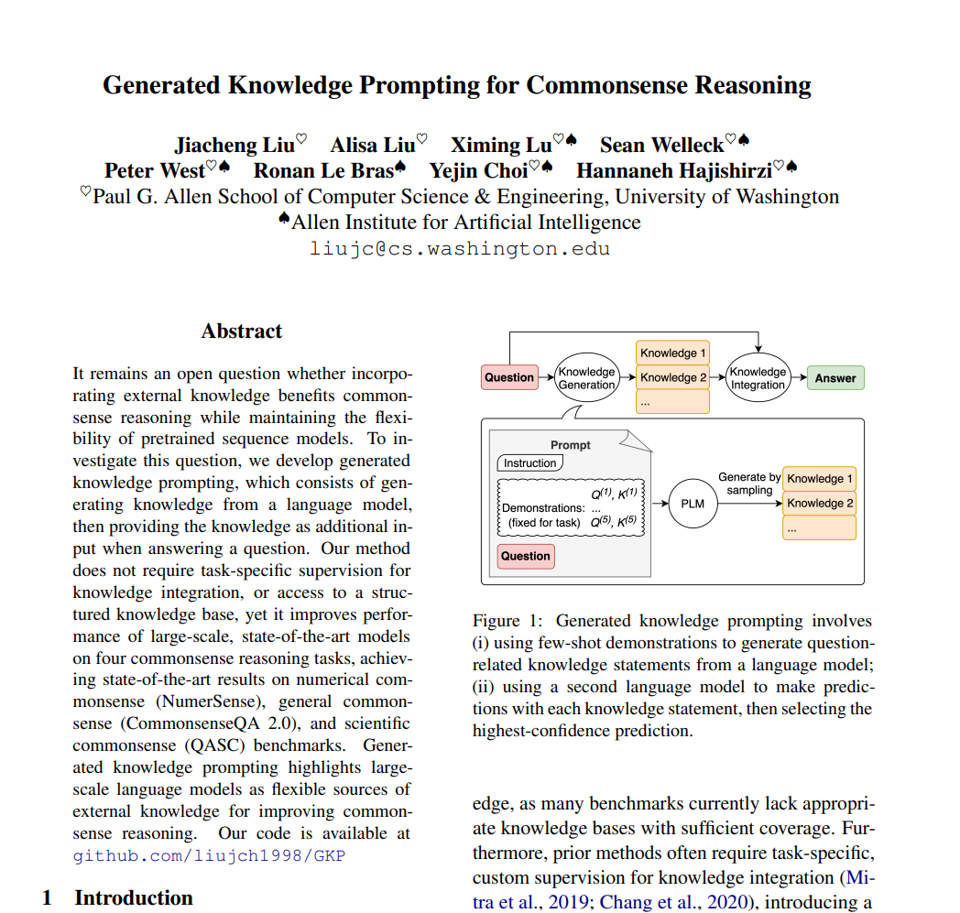

Slide 56
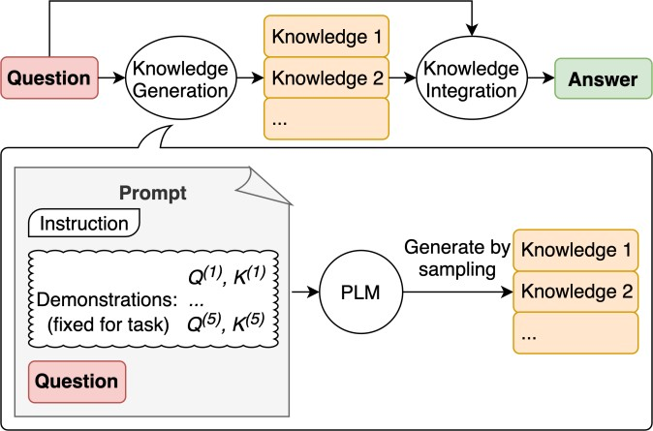
Generate Knowledge Prompting
Using additional knowledge provided as part of the context to improve results on complex tasks such as commonsense reasoning
The knowledge used in the context is generated by a model and used in the prompt to make a prediction
Source: Generated Knowledge Prompting for Commonsense Reasoning

Slide 57
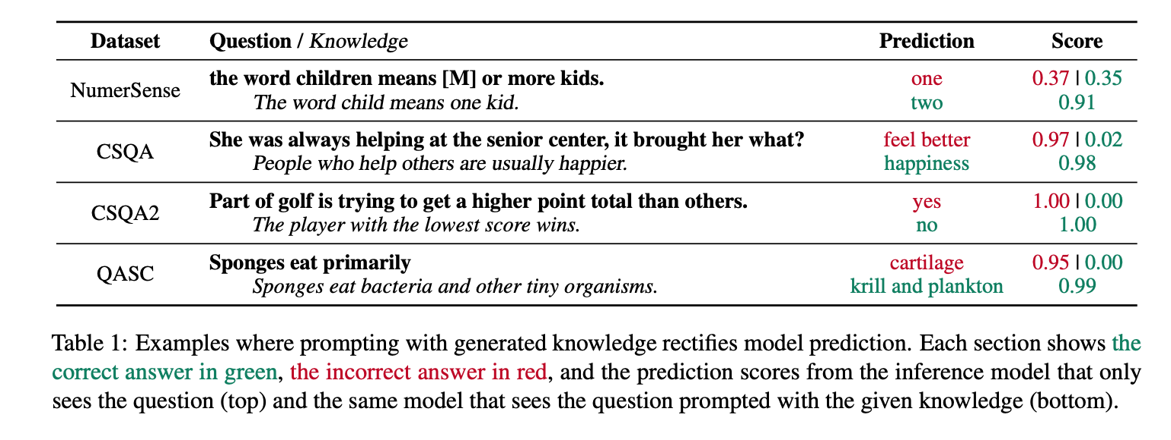
Adding Knowledge to Questions
Source: Generated Knowledge Prompting for Commonsense Reasoning

Slide 58
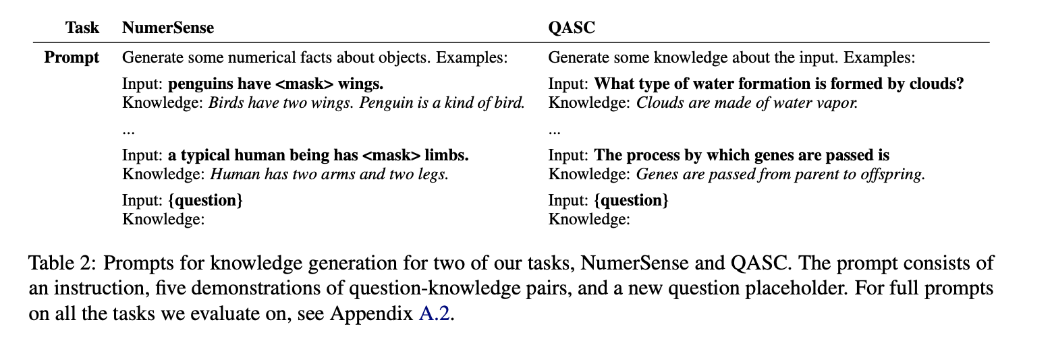
The Knowledge generator
Source: Generated Knowledge Prompting for Commonsense Reasoning

Slide 59
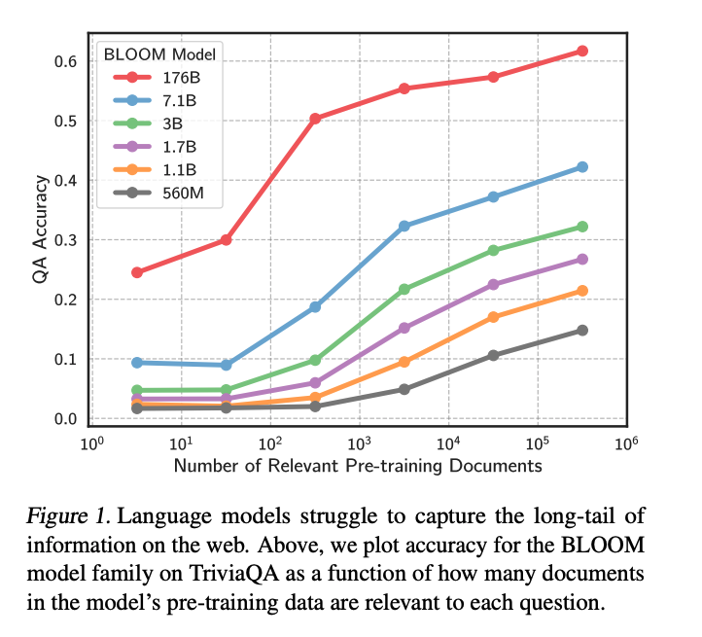
Large Language Models Struggle to Learn Long-Tail Knowledge (Kandpal, ICML2023)

Slide 60
Retrieval-augmented language models
  REALM, Guu et al., ICML 2020
Modifying knowledge in language models
  Modifying Memories in Transformer Models, Zhu et al., arXiv 2020
More multitask pre-training for language models
  KEPLER, Wang et al., TACL 2020
More efficient knowledge systems
  NeurIPS Efficient QA challenge
Better knowledge benchmarks
  KILT, Petroni et al., arXiv 2020

